Slide 1
Cubic spline interpolation & Rational Interpolation with Poles
Spline interpolation is a form of interpolation where the interpolant is a special type of piecewise polynomial called a spline.
Notes:
Spline interpolation is a special case of polynomial interpolation where the interpolant function, at a set of known points used to compute values.

Slide 2
Introduction
Cubic spline interpolation is a special case for Spline interpolation.
It generates an interpolating polynomial that is smoother and has smaller error than interpolating polynomials.
The concept of spline uses a thin strip called a spline to draw smooth curves through a set of points.
Notes:
Cubic spline interpolation is a special case for Spline interpolation. It generates an interpolating polynomial that is smoother and has smaller error compared to interpolating polynomials (e.g. Lagrange polynomial, Newton polynomial).
The concept of spline is using a thin, flexible strip called a spline to draw smooth curves through a set of points.

Slide 3
Significance
Higher order polynomials is not a good idea and cause Runge's phenomenon problem.
Runge's phenomenon is a problem of oscillation at the edges of an
interval that occurs when using polynomial interpolation of high degree.
Notes:
Why use Spline, because higher order polynomials is not a good idea and cause Runge's phenomenon problem. Runge's phenomenon is a problem of oscillation at the edges of an interval that occurs when using polynomial interpolation with polynomials of high degree, usually over a set of equidistantly-spaced interpolation points.

Slide 4
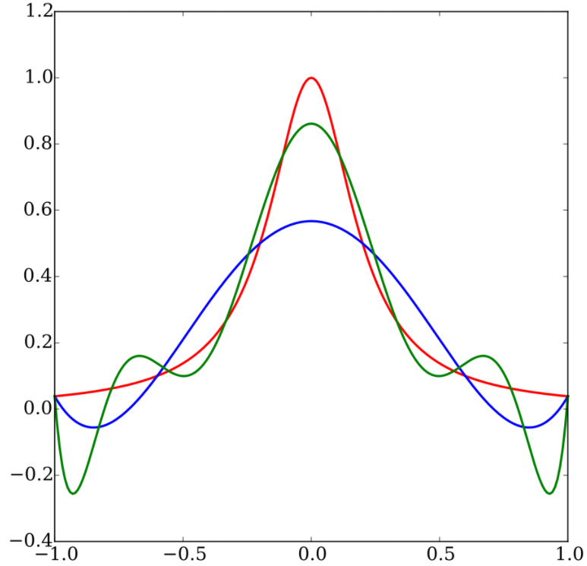
The red curve is the Runge function. The blue curve is a 5th-order interpolating polynomial (using six equally spaced interpolating points). The green curve is a 9th-order interpolating polynomial (using ten equally spaced interpolating points).
Spline provide a better approximation of the behavior of functions having local and abrupt changes.
Notes:
Spline provide a better approximation of the behavior of functions that have local and abrupt changes. Just like the Prof was trying to add value points to the polynomial.

Slide 5
Definition

Slide 6
Assumption

Slide 7
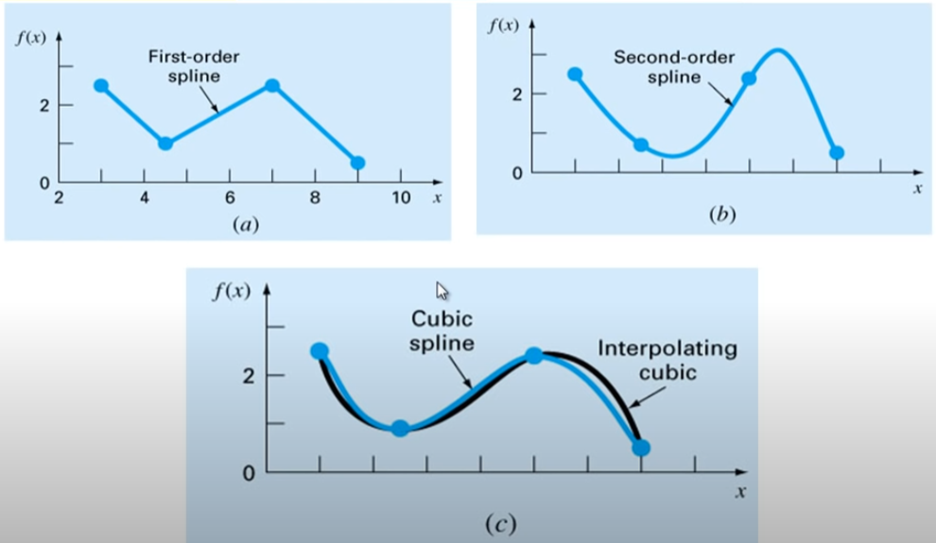
Spline Order

Slide 8
Boundary Conditions:
1 -2 1
A = -2 -1 3
1 3 4
To determine this cubic spline S(x), we need to determine a_{i}, b_{i}, c_{i} and d_{i} for each i with the following conditions:
We can see that there are n +n + (n -1) + (n-1) = 4n – 2 conditions, but we need to determine 4n coefficients, so usually we add two boundary conditions to solve this problem.

Slide 9
Type of Boundary Conditions
There are three types of common boundary conditions:

Slide 10
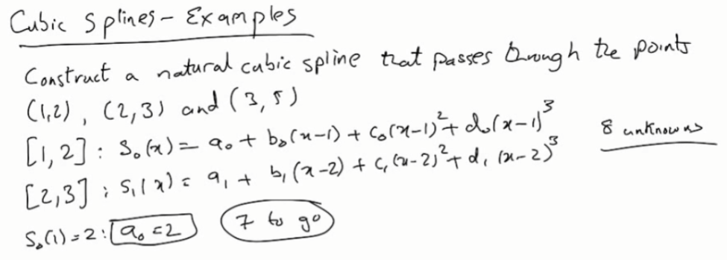
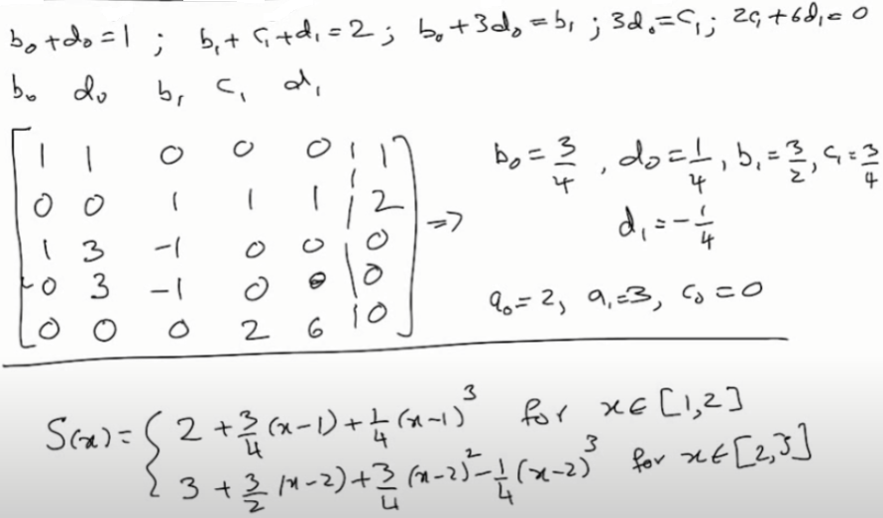
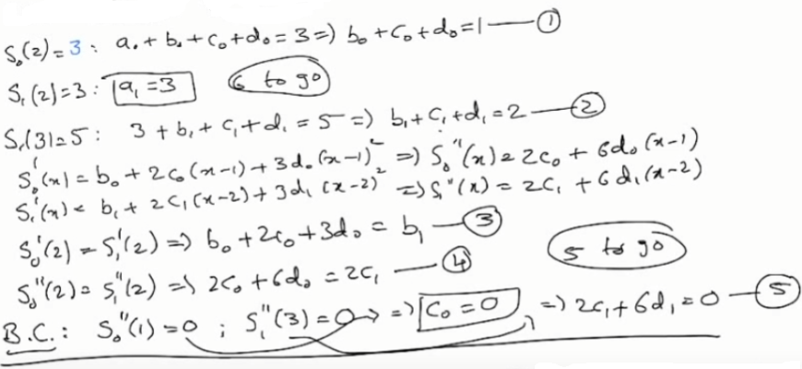
Cholesky Requirement Example (A•x=b)
_{Cubic Splines - Example}
Let
That is for natural cubic spline.
For clamped cubic spline, only the B.C will change.
Notes:
Λ_{1,} λ_{2,} λ₃ > 0.

Slide 11
